Slide 1
Complete Biosynthesis of Opioids in Yeast
Paper by Galanie et al
Presentation by Jamie Arabshahi and Sharifah Omar

Slide 2
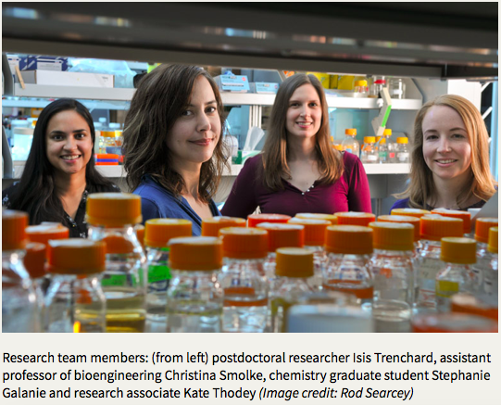

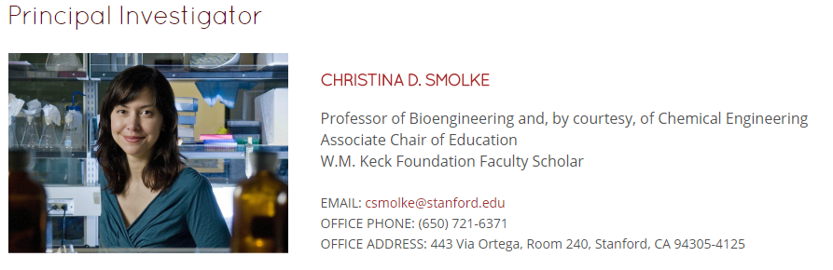

Authors
So the PI for this research was dr. smolke and
http://smolkelab.weebly.com/

Slide 3
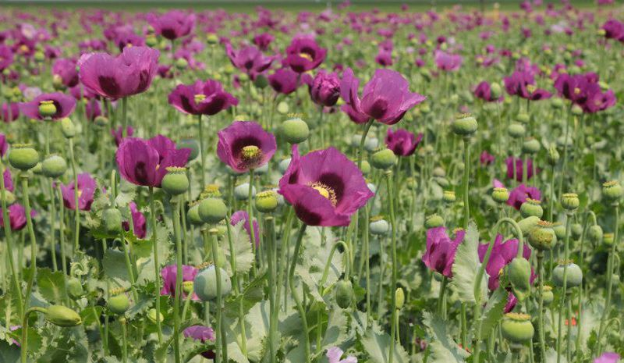
Introduction
Problem: Shortage of painkillers in developing countries from traditional poppy-based supply chain to meet licit medical and scientific demands
Solution: Metabolically engineer yeast to be able to synthesize opioids from sugar (carbon)
Goal: Proof of Principle of replacing opium poppies with yeast produced thebaine and hydrocodone

Slide 4
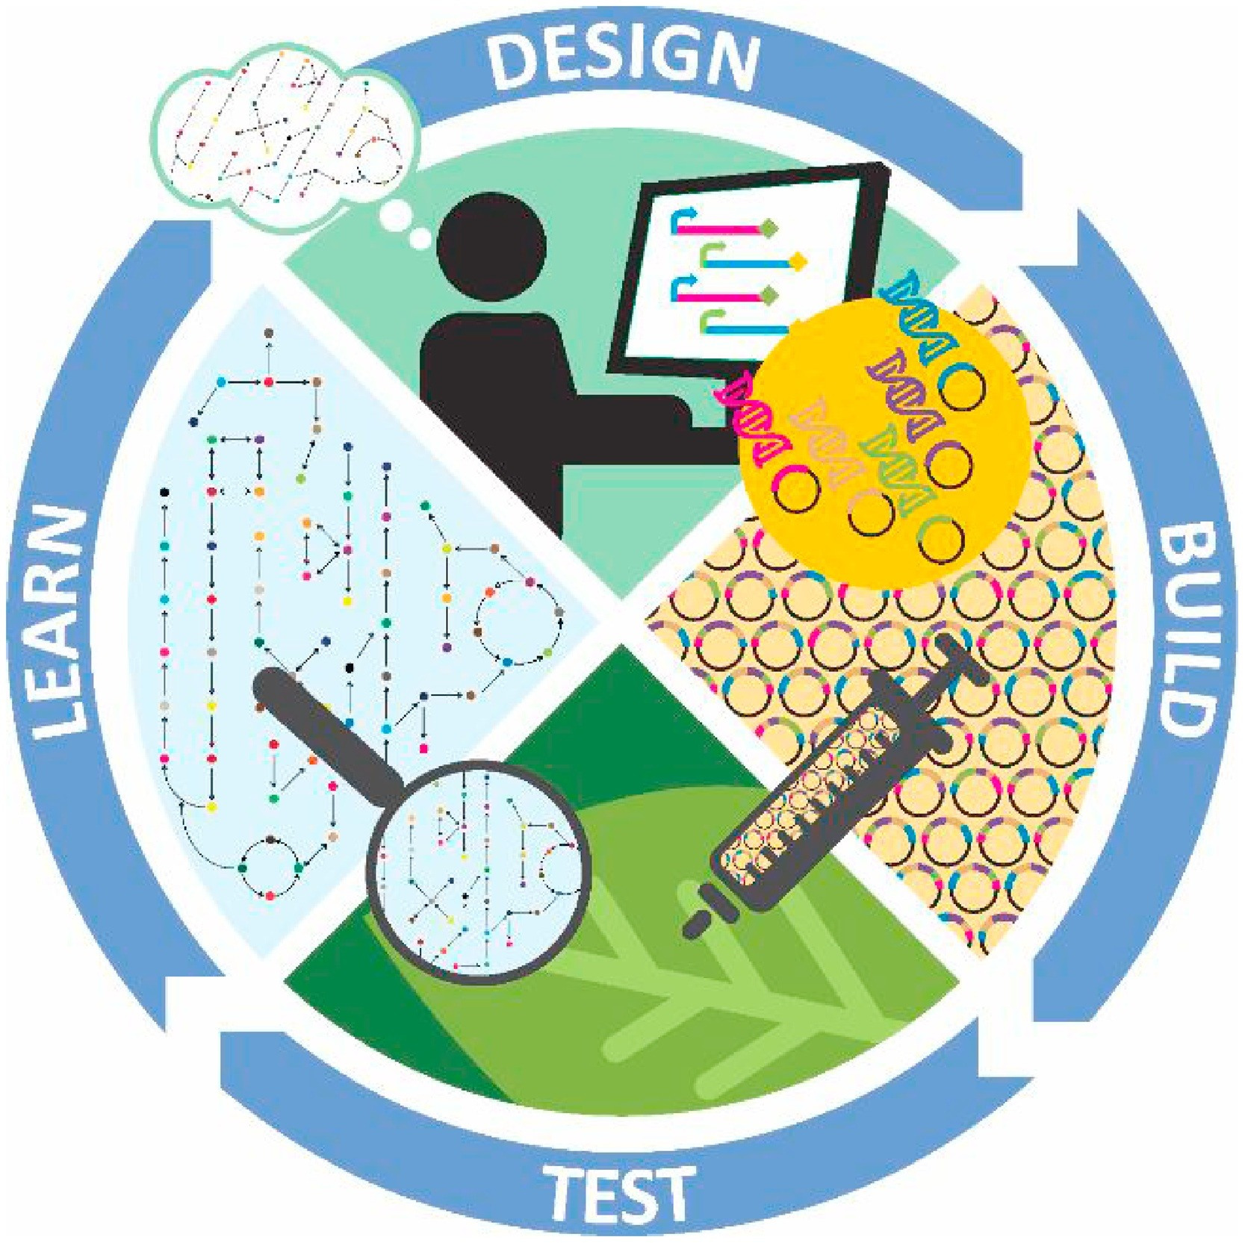
Main Takeaways
Responsible Design
Keeping this in mind when designing
Dual-Use for substance abuse
Iterative Design Cycle
Product Formation Optimization
Recognizing inefficient reactions (i.e., inefficient rate of product accumulations)
Substituting homologs with superior kinetics
Protein engineering heterologous expression
Photo from: Pouvreau, Vanhercke, & Singh. Plant science, 2018.

Slide 5

An Overview on Opioids
World Health Organization (WHO) classification
Opioids are essential for pain management in severe cases
Highly abused, especially heroin
Globally estimated 13.5 million people take opioids, 9.2 of which take heroin
With injections, HIV and Hepatitis transmission are a risk
Abusers often times take other drugs as well, increasing risk of death
http://www.who.int/substance_abuse/facts/opiates/en/
Notes:
Opioid abuse: received permission from Stanford Univeristy’s institutional research registration with the US Drug Enforcement agency which required background screening of researchers, detailed protocols limiting fermenting volumes and compound concentrations including provisions for culture and product destruction and disposal immediately after experiments, increased physical containment for the strains and controlled compounds, increased lab security, explicit management and reporting

Slide 6
Responsible Design
Precautions were taken to ensure that this doesn’t result in opioid abuse.
Sought permission from U.S. Drug Enforcement Agency
Background screening of researchers
Detailed protocols
Increased physical containment for strains and compounds
Increased laboratory security
Explicit management and reporting
Built yeast strain that only produce opioids with additional steps and costs to converting specific compounds to heroin
Additional research, optimization and huge production scale-up is required and thus not economically competitive for “home brew” pursuits.
Notes:
Opioid abuse: received permission from Stanford Univeristy’s institutional research registration with the US Drug Enforcement agency which required background screening of researchers, detailed protocols limiting fermenting volumes and compound concentrations including provisions for culture and product destruction and disposal immediately after experiments, increased physical containment for the strains and controlled compounds, increased lab security, explicit management and reporting

Slide 7
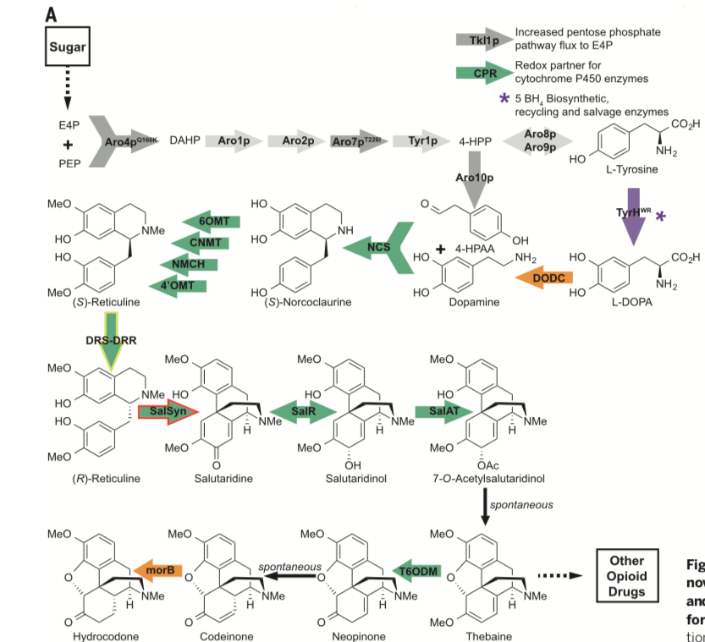
How did they Build the Pathway?
Split the pathway into 4 parts
Tyrosine module
Reticuline biosynthetic pathway
Tyrosine to (S)-reticuline
Thebaine module
(R)-reticuline to Thebaine
Hydrocodone module
Thebaine to hydrocodone
Faced optimization challenges in
Increasing the initial substrates
Finding a missing enzyme
Fixing heterologous expressions of SalSyn Enzyme
Notes:
Discuss the metabolic engineering strategies that were used (overexpression of enzymes, feedback mutants, heterologous expression) What do these accomplish? What is the rationale?
New modular genetic design that incorporated modifications designed to divert greater carbon flux through tyrosine to (S)-reticuline

Slide 8
How did they Build the Pathway?
Problem: Increase production of Tyrosine and Reticuline
Modified the central metabolism of S. cerevisiae to divert carbon flux toward making tyrosine
Overexpressed enzymes of Aro4p, Aro7p and Aro10p to increase accumulation of L-tyrosine
Increased expression of 4´OMT, TyrH and NCS to increase flux to reticuline by incorporation of additional gene copies
Notes:
Discuss the metabolic engineering strategies that were used (overexpression of enzymes, feedback mutants, heterologous expression) What do these accomplish? What is the rationale?
New modular genetic design that incorporated modifications designed to divert greater carbon flux through tyrosine to (S)-reticuline

Slide 9
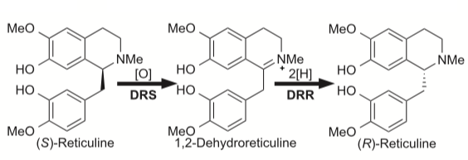
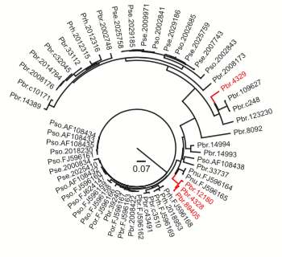
Identifying the Missing Enzyme
Problem: Need a stereospecific enzyme to reduce (S)-reticuline to (R)-reticuline.
Found that knockdown of COR results in high yield of reticuline.
Hypothesized that COR-like enzyme may catalyze stereospecific reduction through both oxidation and reduction for S-reticuline epimerization.
Run Blast query against Papaver species in two plant transcriptome databases.
Found 38 COR-like sequences greater than 300 nucleotides in length.
Notes:
38 COR-like sequences greater than 300 nucleotides in length were found.
Only four had a cytochrome P450 oxidase (CYP) 82Y1-like domain and a COR like domain in a single open reading frame.
Find a COR-like enzyme that could specifically target (S)-reticuline epimerization looking at those which were greater than 300 nucleotides, and could catalyze both oxidation and reduction reactions for epimerization of (S)-reticuline (Homologs)
THEN there was an accumulation of reticuline which indicated that the conversion from (R)-reticuline to salutaridine, catalyzed by SalSyn was in need of optimization

Slide 10
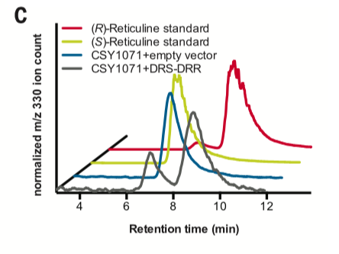
Identifying the Missing Enzyme
Problem: Need a stereospecific enzyme to reduce (S)-reticuline to (R)-reticuline
Out of the final three, only Pbr.89405 from P. bracteatum produced substantial salutaridine.
Did another chiral analysis and found that in strains expressing the DRS-DRR, more than half of the reticuline produced was the (R)- enantiomer, whereas (S)-reticuline was detected in strains lacking the DRS-DRR gene.
Notes:
The chiral analysis indicated that the majority of the reticuline produced is the (S)-enantiomer, as was expected because of the stereospecificity of the NCS-catalyzed condensation.
They needed an enzyme to reduce/convert (S)-reticuline to (R)-reticuline, from which the morphinan alkaloids are derived. They then
Results: In strains expressing the DRS-DRR, more than half of the reticuline produced was the (R)- enantiomer, whereas exclusively (S)-reticuline was detected in strains lacking the DRS-DRR gene (Fig. 2C).
Push/Pull, Feedback, Homologs, Process Optimization
COR knockdown results in reticuline accumulation (pull flux)
They hypothesized that a COR-like enzyme may catalyze the stereospecific reduction from S-reticuline to R-reticuline.
Find a COR-like enzyme that could specifically target (S)-reticuline epimerization looking at those which were greater than 300 nucleotides, and could catalyze both oxidation and reduction reactions for epimerization of (S)-reticuline (Homologs)
THEN there was an accumulation of reticuline which indicated that the conversion from (R)-reticuline to salutaridine, catalyzed by SalSyn was in need of optimization

Slide 11
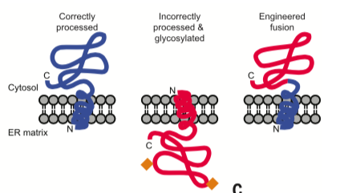
Challenges Encountered in the Heterologous Expression of SalSyn
Problem: Need to increase efficiency of SalSyn when converting R-reticuline to salutaridine
Accumulation of (R)-reticuline in the conversion to salutaridine showed inefficiency in catalyst SalSyn
Found that SalSyn was N-glycosylated rather than anchored in the N-terminus
Mutating the glycosylation sites further reduced the efficiency
Protein engineered a fusion to keep the sites consistent, but use the same protein
Notes:
Incorrect N-terminal sorting of the nascent Salsyn polypeptide to the lumen of the endoplasmic reticulum. However, modifying the glycosylation pattern of SalSyn by mutating the glycosylation sites reduced conversion of (R)-reticuline to salutaridine relative to the wild type yeast codon–optimized enzyme
When they replaced a portion of the protein with the same region from a similar plant protein, the researchers found that the enzyme folded and embedded into intracellular membranes correctly, jump starting the efficiency of the opioid pathway.

Slide 12


Study Conclusion
The resulting opioid biosynthesis strains required the expression of 21 (thebaine) and 23 (hydrocodone) enzyme activities from plants, mammals, bacteria, and yeast
~5ml of yeast grown over several days would provide one dose of pain medication which is sourced from .2m^2 of poppy field land over the course of a year
Limitations:
With each enzymatic step added, the total titer decreased
One of the most complicated gene
engineering projects, reproducibility
https://ae01.alicdn.com/kf/HTB1Cf17KhSYBuNjSsphq6zGvVXaS/Ultra-Large-2-3-People-Sleeping-Outdoor-Parachute-Hammock-3-2m-2-6-1-4-Cot.jpg

Slide 13
Main Takeaways
Responsible Design
Keeping this in mind when designing
Dual-Use for substance abuse
Iterative Design Cycle
Product Formation Optimization
Recognizing inefficient reactions (i.e., inefficient rate of product accumulations)
Substituting homologs with superior kinetics
Protein engineering heterologous expression
Photo from: Pouvreau, Vanhercke, & Singh. Plant science, 2018.

